Slide 1
Data and Computer Communications
Chapter 5 – Signal Encoding Techniques

Slide 2
Encoding
Encoding
is the process of putting a sequence of characters (letters, numbers, punctuation, and certain symbols) into a specialized digital format for efficient transmission or transfer.
Decoding
is the opposite process -- the conversion of a digital signal into a sequence of characters.

Slide 3
Digital data to Analog signals − The modulation techniques such as Amplitude Shift Keying (ASK), Frequency Shift Keying (FSK), Phase Shift Keying (PSK), etc., fall under this category.
Digital data to Digital signals − There are several ways to map digital signals.The simplest form of digital encoding of digital data is to assign one voltage level to binary one and another to binary zero.

Slide 4
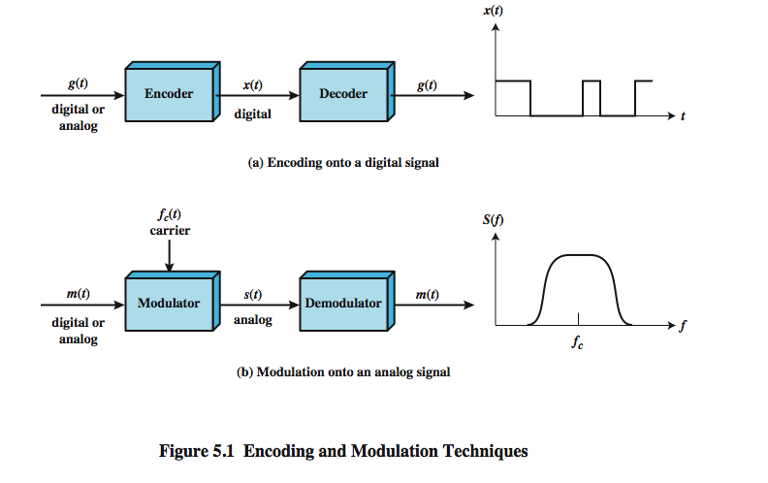
Signal Encoding Techniques

Slide 5
Encoding Techniques
Types
Analog data to Analog signals −
Amplitude Modulation, Frequency Modulation and Phase Modulation of analog signals, fall under this category.
Analog data to Digital signals − This process can be termed as digitization, which is done by Pulse Code Modulation (PCM).Sampling and quantization are the important factors in this.

Slide 6
Digital signaling and analog signaling
Digital signaling, a data source g(t), which may be either digital or analog, is
encoded into a digital signal x(t).
The basis for analog signaling is a continuous constant-frequency signal
known as the carrier signal. The frequency of the carrier signal is chosen to be compatible with the transmission medium being used. Data may be transmitted using a carrier signal by modulation.

Slide 7
Modulation
is the process of encoding source data onto a carrier signal with frequency fc.All modulation techniques involve operation on one or more of the three fundamental frequency domain parameters: amplitude, frequency, and phase.
The input signal m(t) may be analog or digital and is called the modulating signal or baseband signal.The result of modulating the carrier signal is called the
modulated signal s(t).

Slide 8
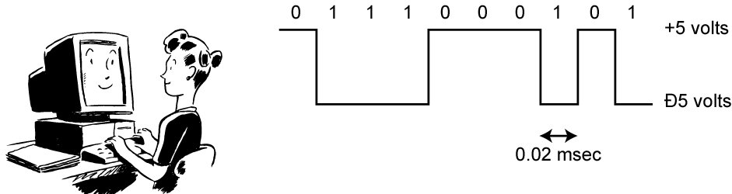
Digital Data, Digital Signal
digital signal
discrete, discontinuous voltage pulses
each pulse is a signal element
binary data encoded into signal elements

Slide 9
Terminology
unipolar – all signal elements have the same sign
polar – one logic state represented by positive voltage and the other by negative voltage
data rate – rate of data ( R ) transmission in bits per second
duration or length of a bit – time taken for transmitter to emit the bit (1/R)
modulation rate – rate at which the signal level changes, measured in baud = signal elements per second.
mark and space – binary 1 and binary 0

Slide 10
Digital Signal Encoding Formats

Slide 11
Digital Signal encoding
Nonreturn to Zero
Nonreturn to Zero-Level (NRZ-L)
Non-return to Zero Inverted (NRZI)
Multilevel Binary
Multilevel Binary Bipolar-AMI
Multilevel Binary Pseudoternary
Biphase
Manchester Encoding
Differential Manchester Encoding

Slide 12
Definition of signal encoding formats
NRZ-L
0-High level,1-Low level
NRZ-I
0-No transition at the beginning of the interval
1-Transition at the beginning of the interval
Bi-polar AMI
0-No signal level
1-Positive or negative levels alternating for successive ones
Psuedoternary
0-Positive or negative levels alternating for successive zeroes
1-No signal level
Manchester
Always a transition in the middle of the interval
0-Transition from high to low in the middle of the interval
1-Transition from low to high in the middle of the interval

Slide 13
Differential Manchestor Encoding
Always a transition at the middle of the interval.
0-Transition at the beginning of the interval
1-No transition at the beginning of the interval
B8ZS
Same as bipolar AMI,except that any string of eight zeroes is replaced with two code violations
HDB3
Same as bipolar AMI ,Except that any string of four zeroes is replaced with one code violation
Case 1:-Previous polarity –ve and number of non zero voltages since the last substitution is odd
Replace with 000-
Case 2:-Previous polariy -ve and number of non zero voltages since the last substitution is even
Replace with +00+
Case 3:-Previous polarity +ve and number of non zero voltages since the last substitution is odd
Replace with 000+
Case4:-Previous polarity +ve and number of non zero voltages since the last substitution is even
Replace with -00-

Slide 14
Nonreturn to Zero-Level (NRZ-L)
Two different voltages for 0 and 1 bits
Voltage constant during bit interval
no transition I.e. no return to zero voltage
e.g. Absence of voltage for zero, constant positive voltage for one
More often, negative voltage for one value and positive for the other
This is NRZ-L

Slide 15
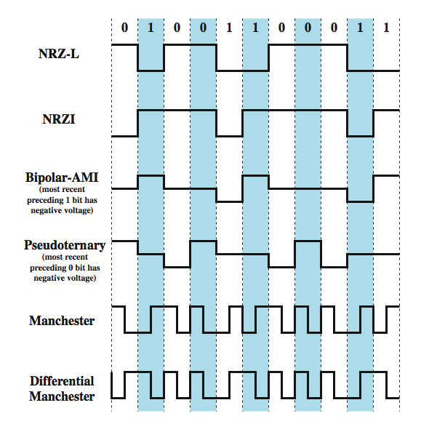
Encoding Schemes

Slide 16
Non-return to Zero Inverted (NRZI)
Non-return to zero, invert on ones
constant voltage pulse for duration of bit
data encoded as presence or absence of signal transition at beginning of bit time
transition (low to high or high to low) denotes binary 1
no transition denotes binary 0
example of differential encoding
data represented by changes
more reliable to detect a transition in the presence of noise than to compare a value to a threshold
Notes:
A variation of NRZ is known as NRZI (Nonreturn to Zero, invert on ones). As with NRZ-L, NRZI maintains a constant voltage pulse for the duration of a bit time. The data themselves are encoded as the presence or absence of a signal transition at the beginning of the bit time. A transition (low to high or high to low) at the beginning of a bit time denotes a binary 1 for that bit time; no transition indicates a binary 0.
In this figure, a negative voltage is equated with binary 1 and a positive voltage with binary 0. This is the opposite of the definition used in virtually all other textbooks. The definition here conforms to the use of NRZ-L in data communications interfaces and the standards that govern those interfaces.
NRZI is an example of differential encoding. In differential encoding, the information to be transmitted is represented in terms of the changes between successive signal elements rather than the signal elements themselves. The encoding of the current bit is determined as follows: if the current bit is a binary 0, then the current bit is encoded with the same signal as the preceding bit; if the current bit is a binary 1, then the current bit is encoded with a different signal than the preceding bit. One benefit of differential encoding is that it may be more reliable to detect a transition in the presence of noise than to compare a value to a threshold. Another benefit is that with a complex transmission layout, it is easy to lose the sense of the polarity of the signal. For example, on a multidrop twisted-pair line, if the leads from an attached device to the twisted pair are accidentally inverted, all 1s and 0s for NRZ-L will be inverted. This does not happen with differential encoding.

Slide 17
Multilevel Binary Bipolar-AMI
use more than two signal levels
Bipolar-AMI
binary 0 represented by no line signal
binary 1 represented by positive or negative pulse
binary 1 pulses alternate in polarity
no loss of sync if a long string of 1s occurs
no net dc component
lower bandwidth
easy error detection

Slide 18
Multilevel Binary Pseudoternary
binary 1 represented by absence of line signal
binary 0 represented by alternating positive and negative pulses
no advantage or disadvantage over bipolar-AMI and each is the basis of some applications

Slide 19

Multilevel Binary Issues
synchronization with long runs of 0’s or 1’s
can insert additional bits that force transitions
scramble data
not as efficient as NRZ
each signal element only represents one bit
receiver distinguishes between three levels: +A, -A, 0
a 3 level system could represent log₂3 = 1.58 bits
requires approximately 3dB more signal power for same probability of bit error

Slide 20
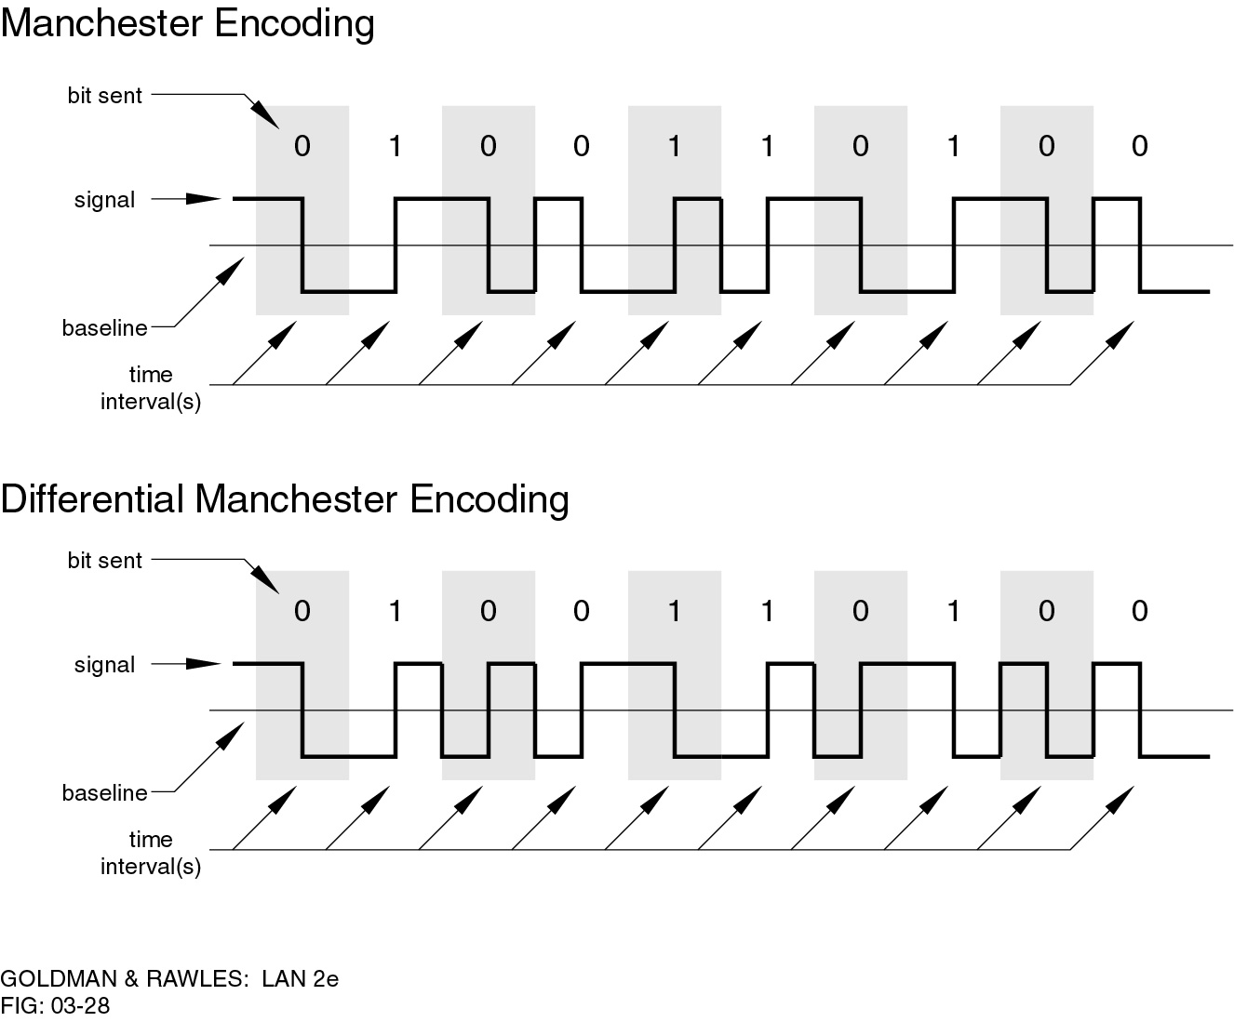
Manchester Encoding
transition in middle of each bit period
midbit transition serves as clock and data
low to high transition represents a 1
high to low transition represents a 0
used by IEEE 802.3

Slide 21
Differential Manchester Encoding
midbit transition is only used for clocking
transition at start of bit period representing 0
no transition at start of bit period representing 1
this is a differential encoding scheme
used by IEEE 802.5
Notes:
In differential Manchester, the midbit transition is used only to provide clocking. The encoding of a 0 is represented by the presence of a transition at the beginning of a bit period, and a 1 is represented by the absence of a transition at the beginning of a bit period. Differential Manchester has the added advantage of employing differential encoding.
The definition of Manchester presented here is the opposite of that used in a number of respectable textbooks, in which a low-to-high transition represents a binary 0 and a high-to-low transition represents a binary 1. Here, we conform to industry practice and to the definition used in the various LAN standards, such as IEEE 802.3.

Slide 22
Biphase (Manchester and differential manchester-Pros and Cons
Cons
at least one transition per bit time and may have two
maximum modulation rate is twice NRZ
requires more bandwidth
Pros
synchronization on midbit transition (self clocking)
has no dc component
has error detection

Slide 23
Scrambling
use scrambling to replace sequences that would produce constant voltage
these filling sequences must:
produce enough transitions to sync
be recognized by receiver & replaced with original
be same length as original
design goals
have no dc component
have no long sequences of zero level line signal
have no reduction in data rate
give error detection capability

Slide 24
Bipolar with 8 zeros substitution
The coding scheme is based on a bipolar-AMI.The drawback of the AMI code is that a long string of zeros may result in loss of synchronization. To overcome this problem, the encoding is,amended with the following rules:
• If an octet of all zeros occurs and the last voltage pulse preceding this octet was positive, then the eight zeros of the octet are encoded as 00+-0-+

Slide 25
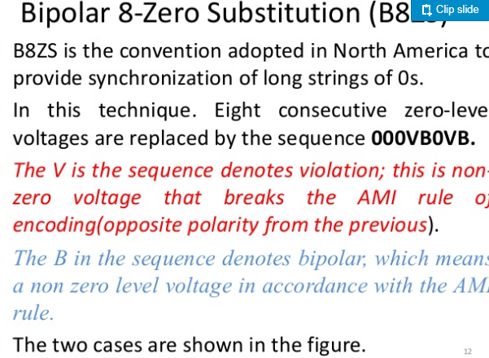

Slide 26
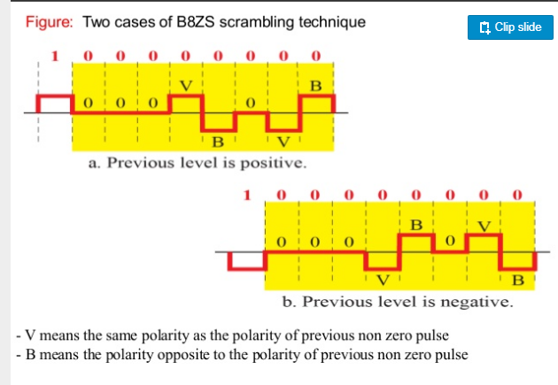
B8ZS

Slide 27
HDB3
is based on the use of AMI encoding. In this case, the scheme replaces strings of four zeros with sequences containing one or two pulses. In each case, the fourth zero is replaced with a code violation.
In addition, a rule is needed to ensure that successive violations are of alternate polarity so that no dc component is introduced.
Thus, if the last violation was positive, this violation must be negative and vice versa

Slide 28
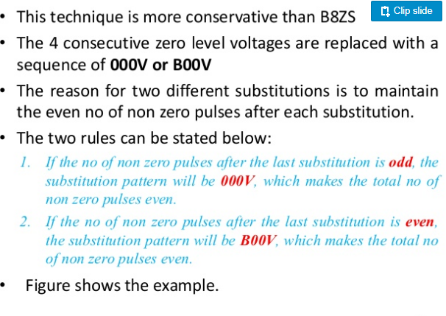

Slide 29
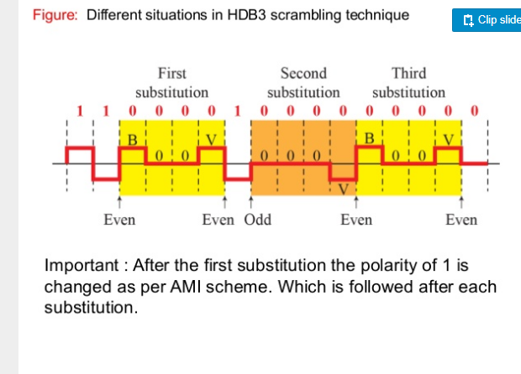

Slide 30
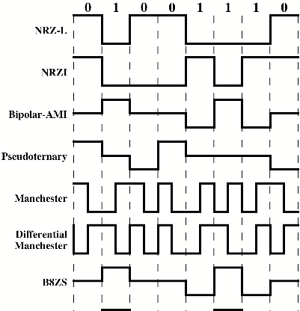


Slide 31
Consider a stream of binary data consisting of a long sequence of 1s followed by a zero followed by a long string of 1s, with the same assumptions as previous question. Draw the waveform for this sequence using
a. NRZ-L
b. Bipolar-AMI
c. Pseudoternary

Slide 32
Digital Data, Analog Signal
Modulation involves operation on one or more of the three characteristics of a carrier signal: amplitude, frequency, and phase.
There are three basic modulation techniques for transforming digital data into analog signals, amplitude shift keying
(ASK), frequency shift keying (FSK), and phase shift keying (PSK).

Slide 33
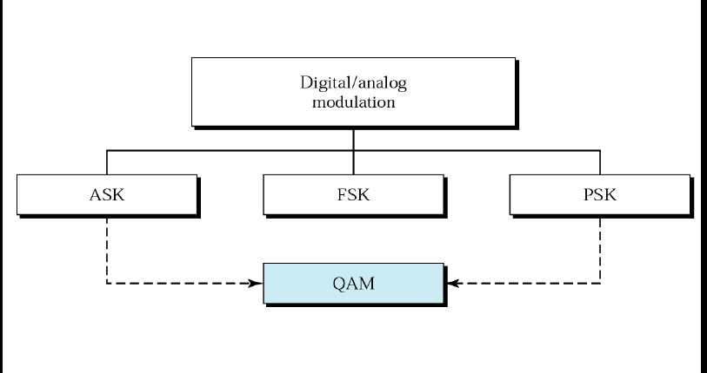
Digital Data, Analog Signal

Slide 34
Digital Data, Analog Signal
Encoding Techniques
Amplitude shift keying (ASK)
used to transmit digital data over optical fiber
Frequency shift keying (FSK)
most common form is binary FSK (BFSK)
Phase shift keying (PK)
phase of carrier signal is shifted to represent data
main use is public telephone system
has frequency range
of 300Hz to 3400Hz
uses modem (modulator-demodulator)
Notes:
We turn now to the case of transmitting digital data using analog signals. The most familiar use of this transformation is for transmitting digital data through the public telephone network. The telephone network was designed to receive, switch, and transmit analog signals in the voice-frequency range of about 300 to 3400 Hz. It is not at present suitable for handling digital signals from the subscriber locations (although this is beginning to change). Thus digital devices are attached to the network via a modem (modulator-demodulator), which converts digital data to analog signals, and vice versa.
For the telephone network, modems are used that produce signals in the voice-frequency range. The same basic techniques are used for modems that produce signals at higher frequencies (e.g., microwave). This section introduces these techniques and provides a brief discussion of the performance characteristics of the alternative approaches.

Slide 35
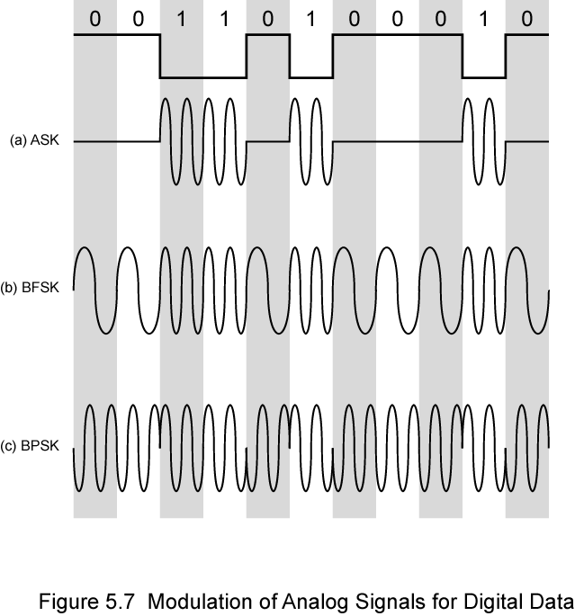
Modulation Techniques

Slide 36
Amplitude Shift Keying
encode 0/1 by different carrier amplitudes
usually have one amplitude zero
susceptible to sudden gain changes
inefficient
used for:
up to 1200bps on voice grade lines
very high speeds over optical fiber

Slide 37

Amplitude Shift Keying

Slide 38
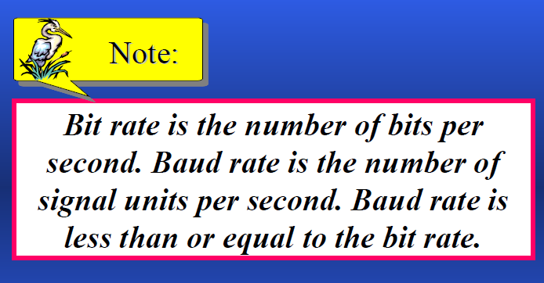

Slide 39
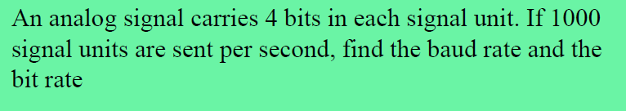

Slide 40
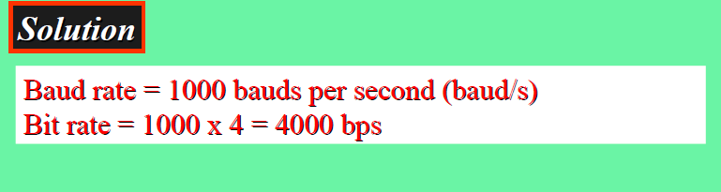

Slide 41
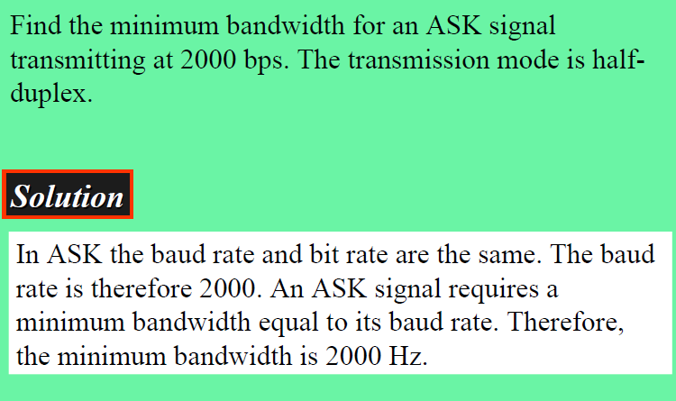

Slide 42
Binary Frequency Shift Keying
two binary values represented by two different frequencies (near carrier)
less susceptible to error than ASK
used for:
up to 1200bps on voice grade lines
high frequency radio
even higher frequency on LANs using coaxial cable

Slide 43

where f1 and f2 are typically offset from the carrier frequency by equal but opposite amounts.

Slide 44
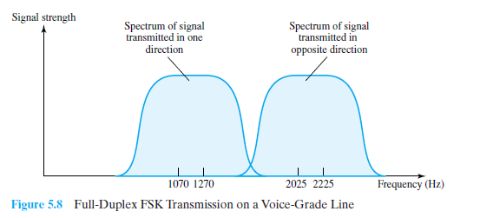

Slide 45

Multiple FSK
each signalling element represents more than one bit
more than two frequencies used
more bandwidth efficient
more prone to error

Slide 46
Phase Shift Keying
phase of carrier signal is shifted to represent data
binary PSK
two phases represent two binary digits
differential PSK
phase shifted relative to previous transmission rather than some reference signal

Slide 47

BPSK

Slide 48
DPSK
An alternative form of two-level PSK
A binary 0 is represented by sending a signal burst of the same phase as the previous signal burst sent.A binary 1 is represented by sending a signal burst of opposite phase to the preceding one.
The term differential refers
to the fact that the phase shift is with
reference to the previous bit transmitted rather
than to some constant reference signal.

Slide 49
Quadrature PSK
more efficient use if each signal element represents more than one bit
uses phase shifts separated by multiples of π/2 (90º)
each element represents two bits
split input data stream in two and modulate onto carrier and phase shifted carrier
can use 8 phase angles and more than one amplitude
9600bps modem uses 12 angles, four of which have two amplitudes

Slide 50
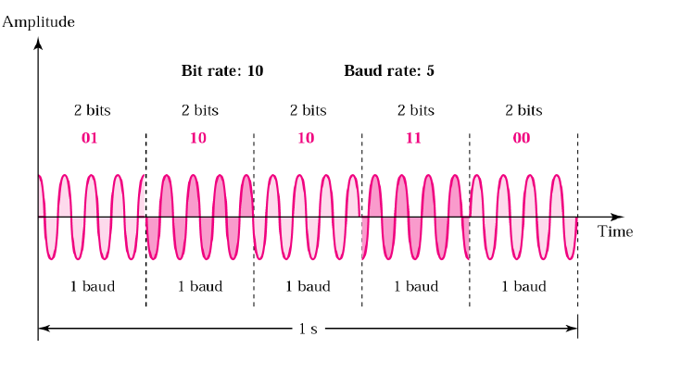

Slide 51
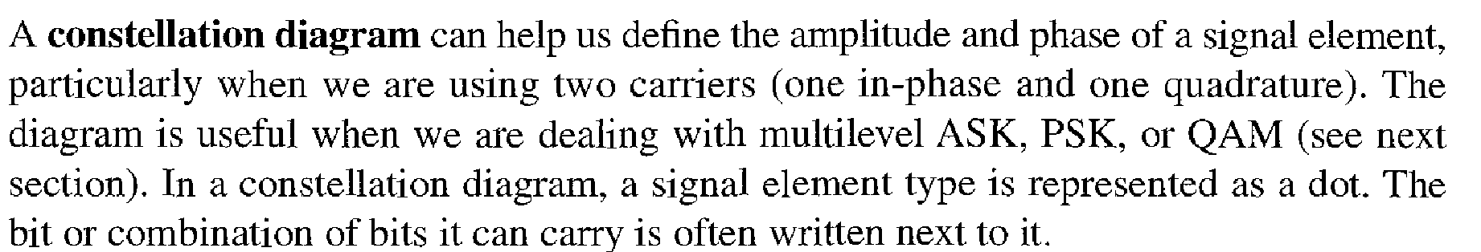

Slide 52
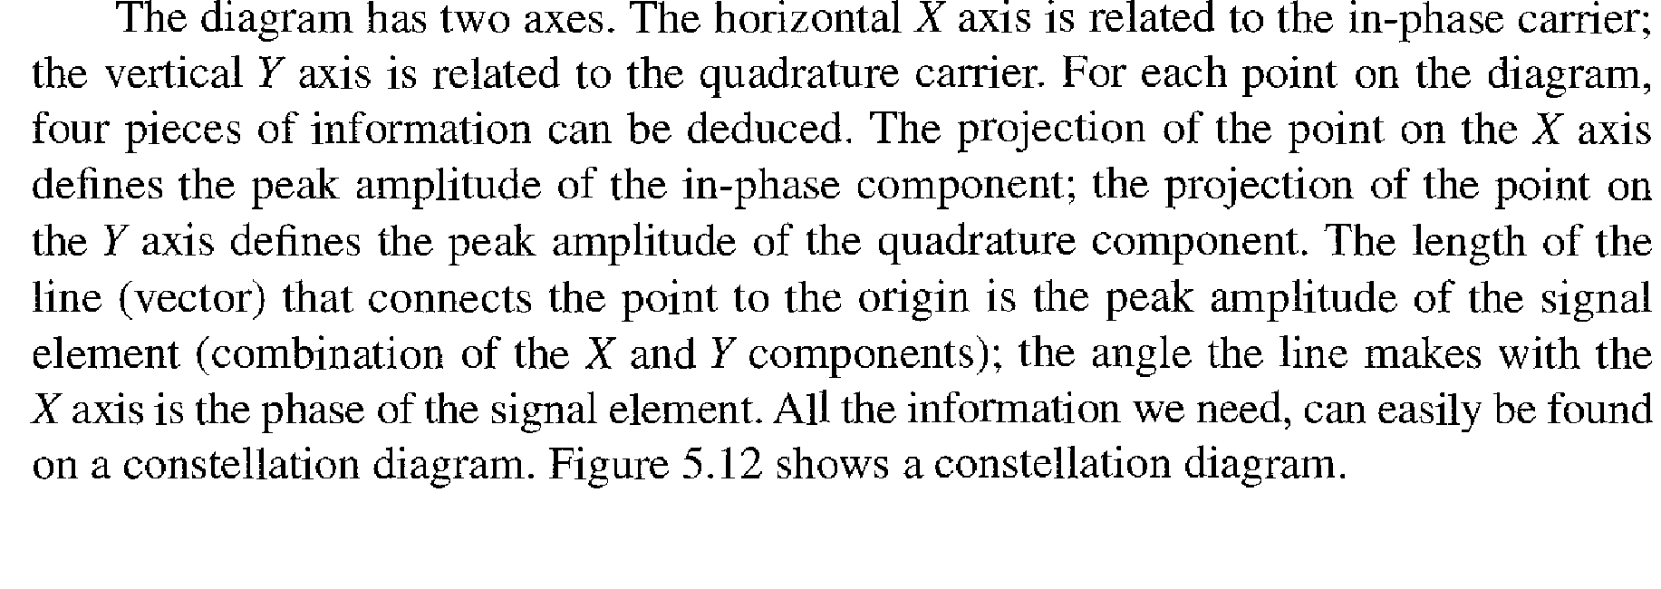

Slide 53
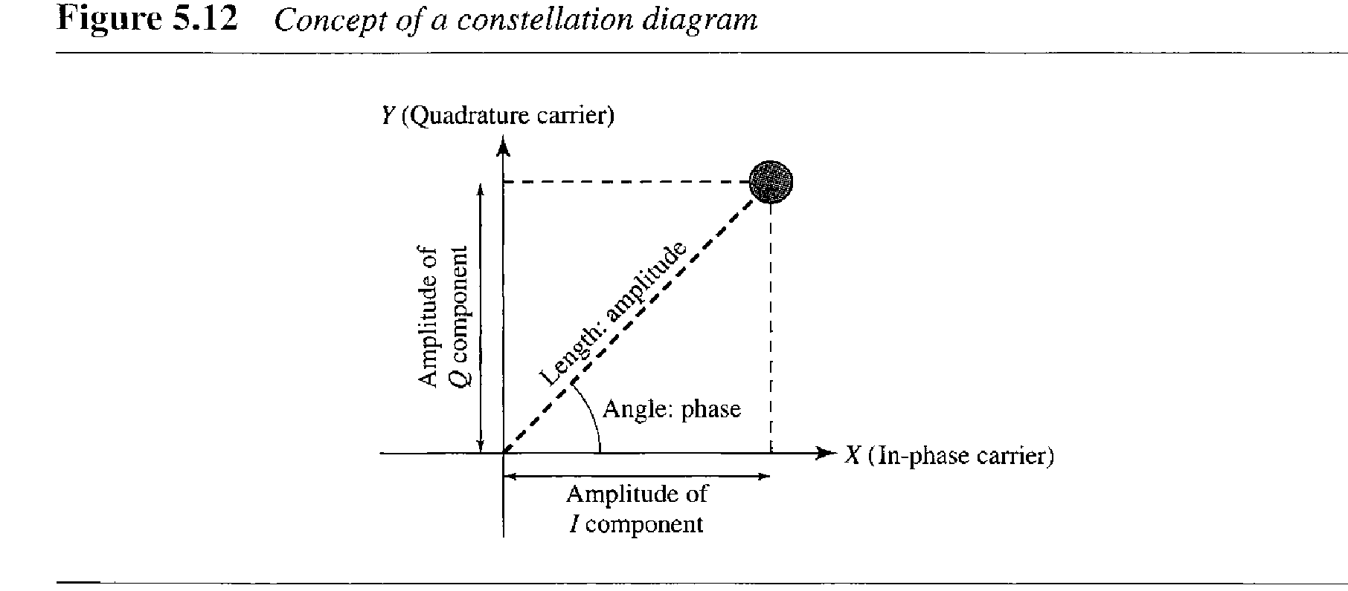

Slide 54
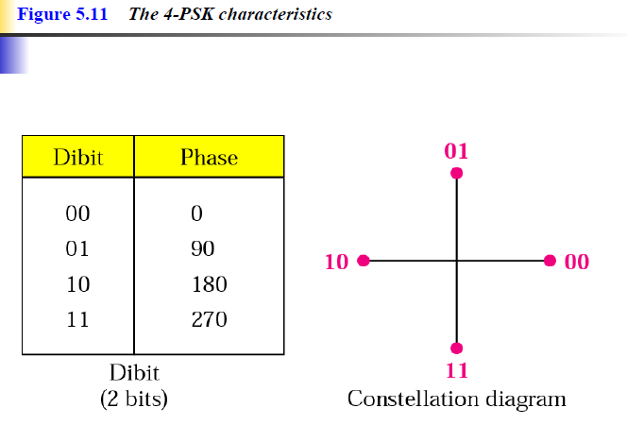

Slide 55
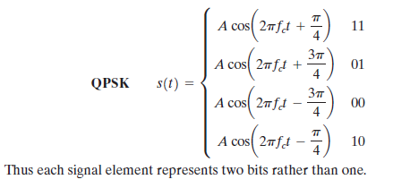

Slide 56
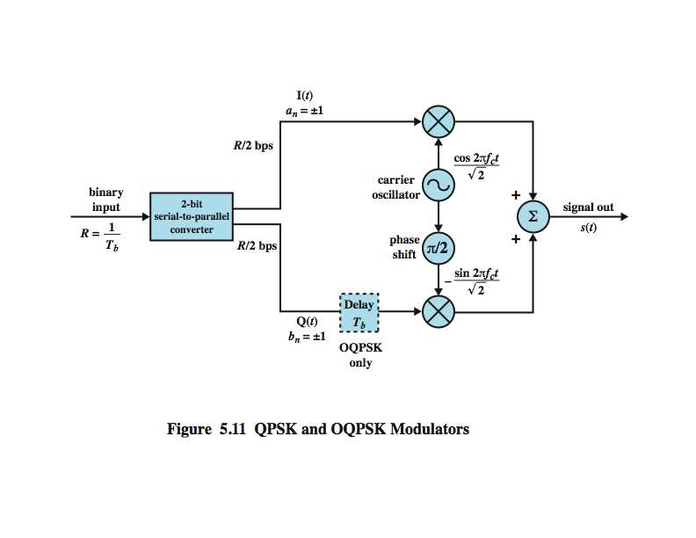
QPSK and OQPSK Modulators

Slide 57
The input is a stream of binary digits,it is is converted into two separate bit streams by taking alternate bits for the two streams,referred to as the I (in-phase) and Q (quadrature phase) streams.
the upper stream is modulated on a carrier of frequency by multiplying the bit stream by the carrier.

Slide 58
This same carrier wave is shifted by 90° and used for modulation of the lower binary stream. The two modulated signals are then added together and transmitted.

Slide 59
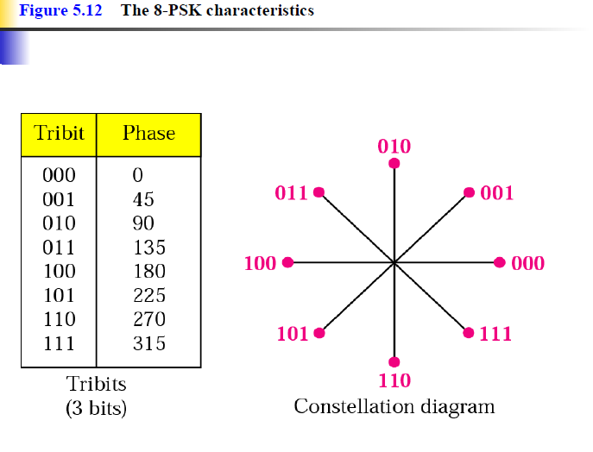

Slide 60
Performance of Digital to Analog Modulation Schemes
bandwidth
ASK/PSK bandwidth directly relates to bit rate
multilevel PSK gives significant improvements
in presence of noise:
bit error rate of PSK and QPSK are about 3dB superior to ASK and FSK
for MFSK and MPSK have tradeoff between bandwidth efficiency and error performance
Notes:
In looking at the performance of various digital-to-analog modulation schemes, the first parameter of interest is the bandwidth of the modulated signal. This depends on a variety of factors, including the definition of bandwidth used and the filtering technique used to create the bandpass signal. For ASK & PSK the bandwidth is directly related to the bit rate. With multilevel PSK (MPSK), significant improvements in bandwidth can be achieved.
Nothing has yet been said of performance in the presence of noise. Stallings DCC9e Figure 5.4 shows the bit error rate plotted as a function of the ratio E_{b}/N₀. As that ratio increases, the bit error rate drops. Further, DPSK and BPSK are about 3 dB superior to ASK and BFSK.

Slide 61
Quadrature Amplitude Modulation
QAM used on asymmetric digital subscriber line (ADSL) and some wireless
combination of ASK and PSK
logical extension of QPSK
send two different signals simultaneously on same carrier frequency
use two copies of carrier, one shifted 90°
each carrier is ASK modulated
two independent signals over same medium
demodulate and combine for original binary output
Notes:
Quadrature amplitude modulation (QAM) is a popular analog signaling technique that is used in the asymmetric digital subscriber line (ADSL) and in cable modems, described in Stallings DCC9e Chapter 8, and in some wireless standards. This modulation technique is a combination of ASK and PSK. QAM can also be considered a logical extension of QPSK. QAM takes advantage of the fact that it is possible to send two different signals simultaneously on the same carrier frequency, by using two copies of the carrier frequency, one shifted by 90˚ with respect to the other. For QAM, each carrier is ASK modulated. The two independent signals are simultaneously transmitted over the same medium. At the receiver, the two signals are demodulated and the results combined to produce the original binary input.

Slide 62
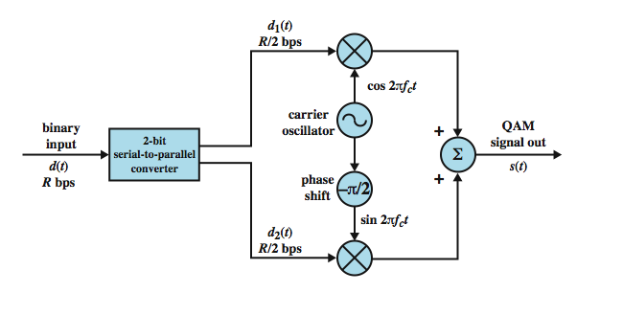
QAM Modulator
Notes:
Stallings DCC9e Figure 5.14 shows the QAM modulation scheme in general terms. The input is a stream of binary digits arriving at a rate of R bps. This stream is converted into two separate bit streams of R/2 bps each, by taking alternate bits for the two streams. In the diagram, the upper stream is ASK modulated on a carrier of frequency f_{c} by multiplying the bit stream by the carrier. Thus, a binary zero is represented by the absence of the carrier wave and a binary one is represented by the presence of the carrier wave at a constant amplitude. This same carrier wave is shifted by 90˚ and used for ASK modulation of the lower binary stream. The two modulated signals are then added together and transmitted.

Slide 63
QAM Variants
two level ASK
each of two streams in one of two states
four state system
essentially QPSK
four level ASK
combined stream in one of 16 states
have 64 and 256 state systems
improved data rate for given bandwidth
increased potential error rate

Slide 64
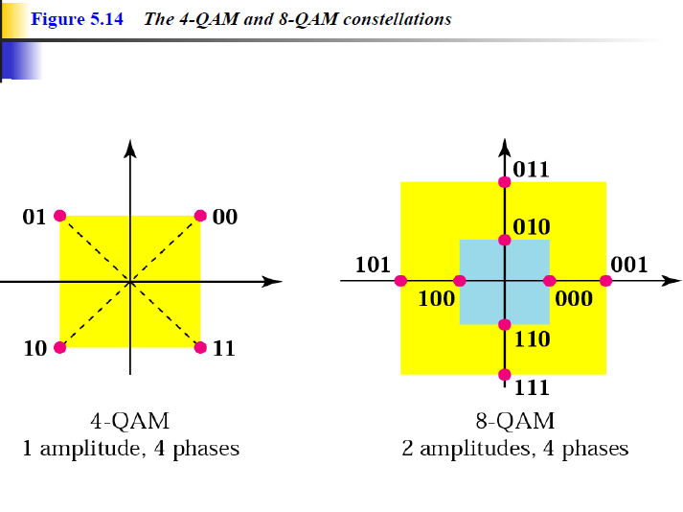

Slide 65
Analog Data, Digital Signal
digitization is conversion of analog data into digital data which can then:
be transmitted using NRZ-L
be transmitted using code other than NRZ-L
be converted to analog signal
analog to digital conversion done using a codec
pulse code modulation
delta modulation

Slide 66
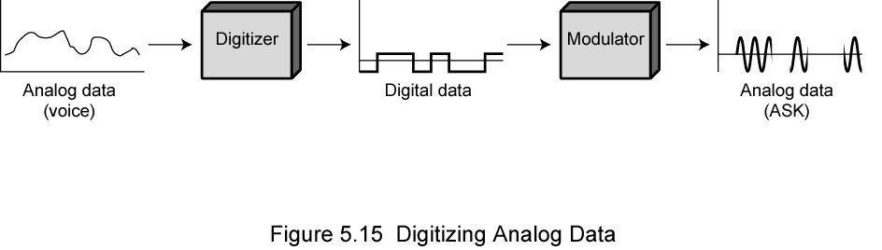
Digitizing Analog Data

Slide 67
Pulse Code Modulation (PCM)
sampling theorem:
“If a signal is sampled at regular intervals at a rate higher than twice the highest signal frequency, the samples contain all information in original signal”
eg. 4000Hz voice data, requires 8000 sample per second
strictly have analog samples
Pulse Amplitude Modulation (PAM)
assign each a digital value

Slide 68
PAM samples
Analog samples are called pulse amplitude
modulation (PAM) samples.
To convert to digital, each of these analog samples it must be assigned a binary code, called as PCM code

Slide 69
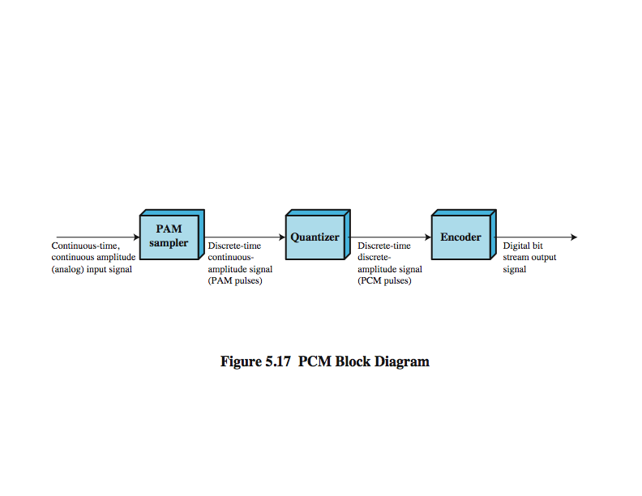
PCM Block Diagram

Slide 70
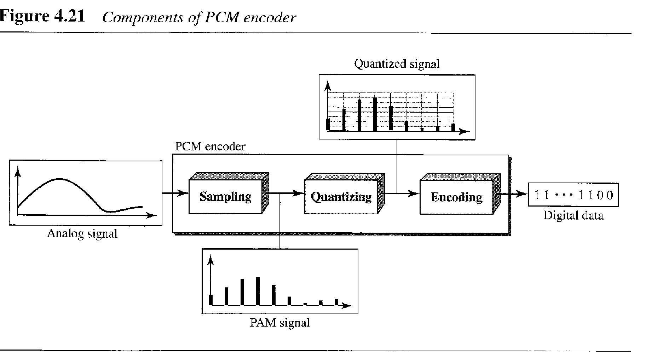

Slide 71
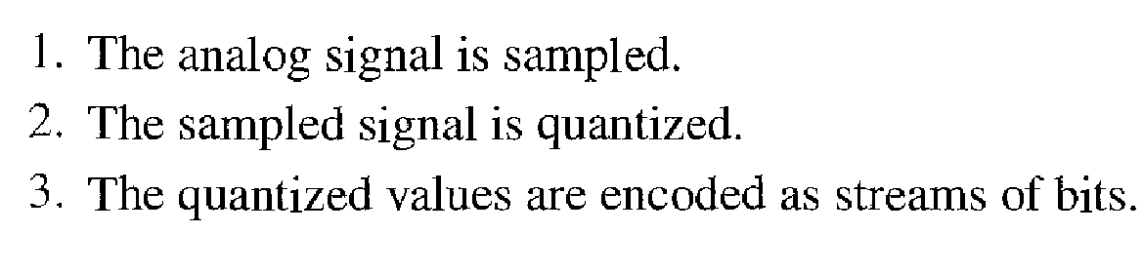

Slide 72
Quantization is the process of mapping input values from a large set (often a continuous set) to output values in a (countable) smaller set.
The difference between an input value and its quantized value (such as round-off error) is referred to as quantization error.

Slide 73
One of the basic choices in quantization is the number of discrete quantization levels to use.
with N bits we can represent.

Slide 74
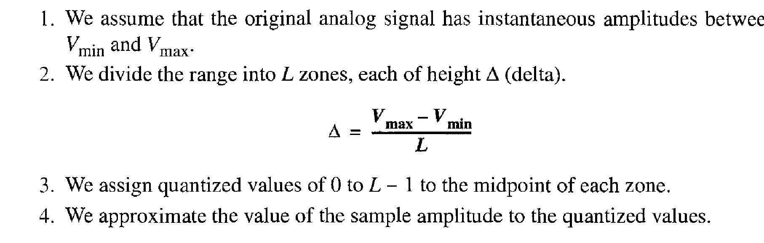

Slide 75

n is number of bits used for quantization

Slide 76
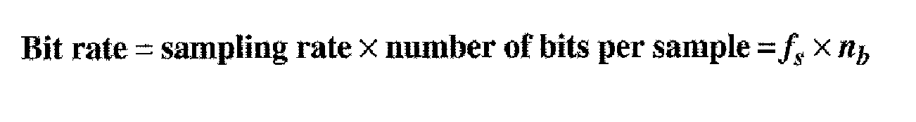
PCM

Slide 77
The same effect can be achieved by using uniform quantizing but companding
(compressing-expanding) the input analog signal.
Companding is a process that compresses the intensity range of a signal by imparting more gain to weak signals than to strong signals on input. At output, the reverse operation is performed.

Slide 78
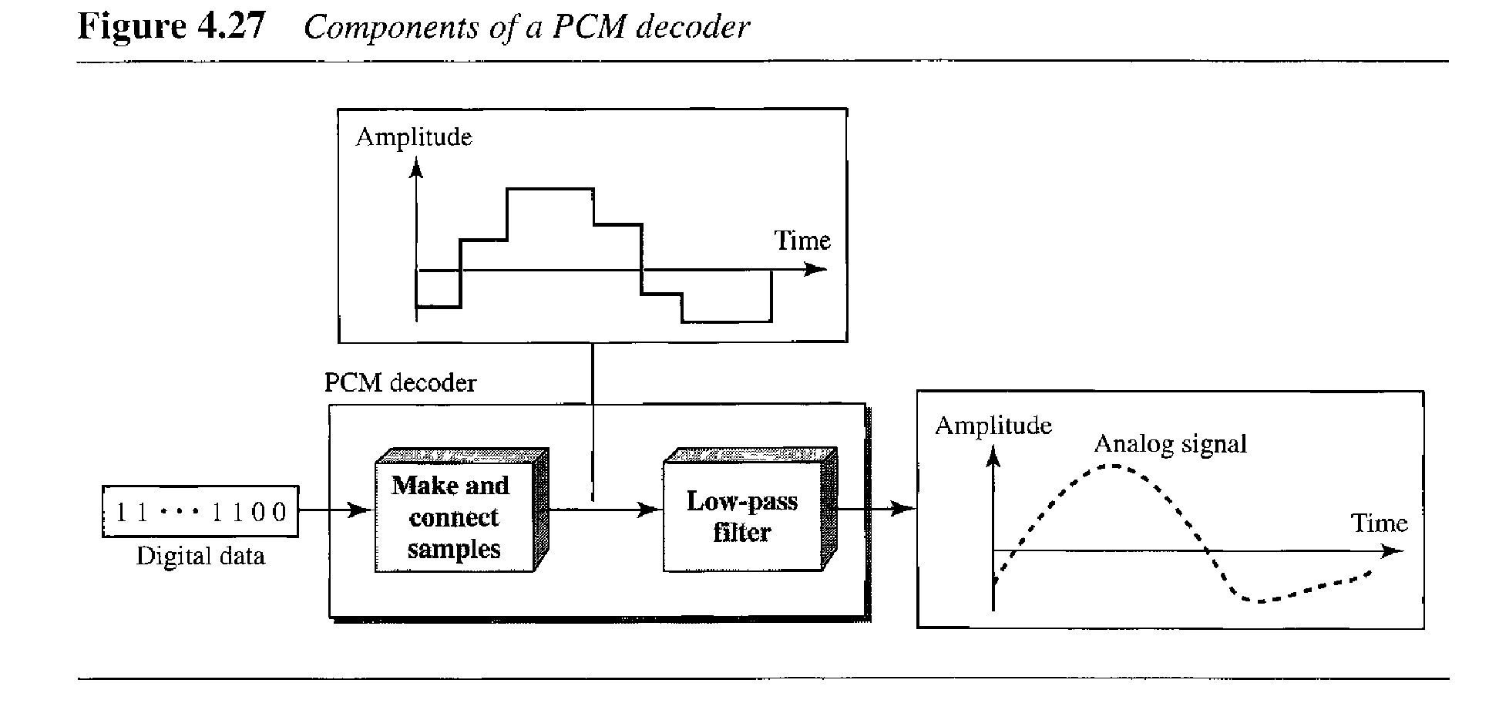
PCM decoder

Slide 79
Delta Modulation (DM)
analog input is approximated by a staircase function
can move up or down one level (δ) at each sample interval
has binary behavior
function only moves up or down at each sample interval
hence can encode each sample as single bit
1 for up or 0 for down
Notes:
A variety of techniques have been used to improve the performance of PCM or to reduce its complexity. One of the most popular alternatives to PCM is delta modulation (DM). With delta modulation, an analog input is approximated by a staircase function that moves up or down by one quantization level (δ) at each sampling interval (T_{s}). The important characteristic of this staircase function is that its behavior is binary: At each sampling time, the function moves up or down a constant amount δ. Thus, the output of the delta modulation process can be represented as a single binary digit for each sample. In essence, a bit stream is produced by approximating the derivative of an analog signal rather than its amplitude: A 1 is generated if the staircase function is to go up during the next interval; a 0 is generated otherwise.

Slide 80
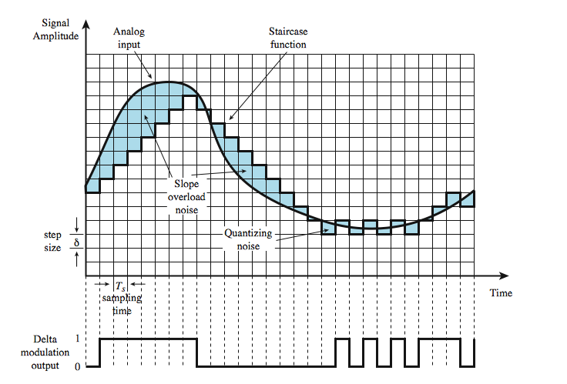
Delta Modulation Example

Slide 81
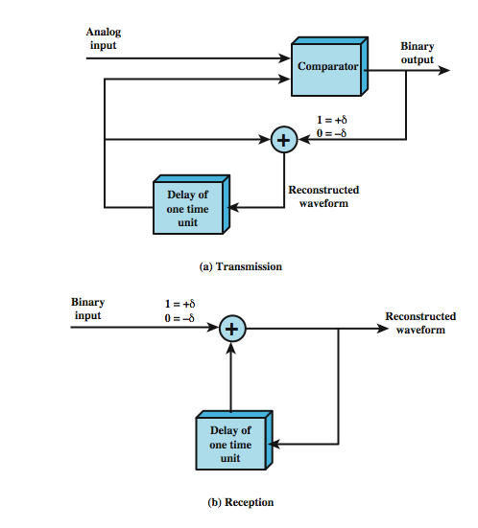
Delta Modulation Operation
Notes:
l.

Slide 82
THE CURRENT INPUT SIGNAL SAMPLE IS GREATER THAN THE PREVIOUS SAMPLE THEN THE DM GENERATE +DELTA
THE CURRENT INPUT SIGNAL SAMPLE IS GREATER THAN THE PREVIOUS SAMPLE THEN THE DM GENERATE -DELTA

Slide 83
PCM verses Delta Modulation
DM has simplicity compared to PCM but has worse SNR
issue of bandwidth used
for good voice reproduction with PCM:
want 128 levels (7 bit) & voice bandwidth 4khz
need 8000 x 7 = 56kbps
data compression can improve on this
still growing demand for digital signals
use of repeaters, TDM, efficient switching
PCM preferred to DM for analog signals

Slide 84
Analog Data, Analog Signals
modulate carrier frequency with analog data
why modulate analog signals?
higher frequency can give more efficient transmission
permits frequency division multiplexing
types of modulation:
Amplitude
Frequency
Phase

Slide 85

Chapter 5
Analog Transmission
Copyright © The McGraw-Hill Companies, Inc. Permission required for reproduction or display.

Slide 86
5-2 ANALOG AND DIGITAL
Analog-to-analog conversion is the representation of analog information by an analog signal. One may ask why we need to modulate an analog signal; it is already analog. Modulation is needed if the medium is bandpass in nature or if only a bandpass channel is available to us.
Topics discussed in this section:
Amplitude Modulation
Frequency Modulation
Phase Modulation

Slide 87
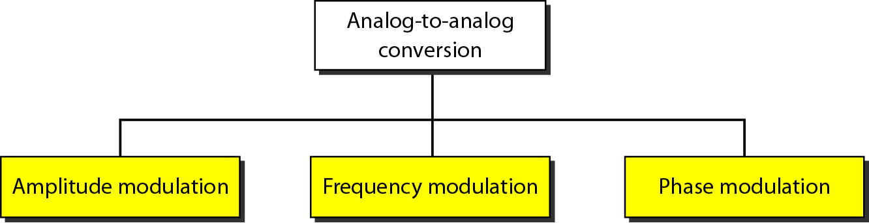
Figure 5.15 Types of analog-to-analog modulation

Slide 88
Amplitude Modulation
A carrier signal is modulated only in amplitude value
The modulating signal is the envelope of the carrier
The required bandwidth is 2B, where B is the bandwidth of the modulating signal
Since on both sides of the carrier freq. f_{c}, the spectrum is identical, we can discard one half, thus requiring a smaller bandwidth for transmission.

Slide 89
Amplitude Modulation
Amplitude modulation (AM) is the simplest form of modulation .
Mathematically, the process can be expressed as
Where is the carrier and x(t) is the input signal (carrying data), both normalized
to unity amplitude.
The parameter known as the modulation index, is the ratio of the amplitude of the input signal to the carrier.

Slide 90
The “1” in the Equation is a dc component that prevents loss of information
This scheme is also known as double sideband transmitted carrier (DSBTC)

Slide 91
s(t) contains unnecessary components, because each of the sidebands contains the complete spectrum of m(t).
A popular variant of AM,known as single sideband (SSB), takes advantage of this fact by sending only one of the sidebands, eliminating the other sideband and the carrier.
Advantages
Only half the bandwidth is required
Less power is required

Slide 92
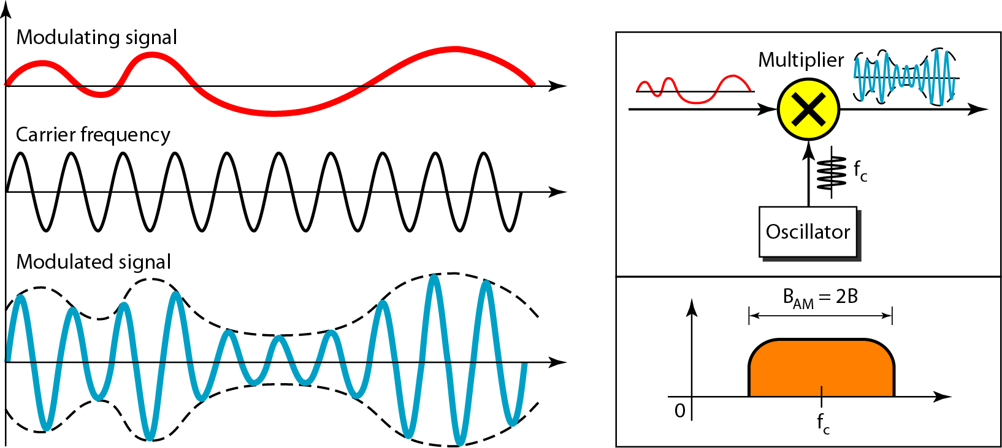
Figure 5.16 Amplitude modulation

Slide 93
Frequency Modulation
The modulating signal changes the freq. f_{c} of the carrier signal
The bandwidth for FM is high
It is approx. 10x the signal frequency

Slide 94
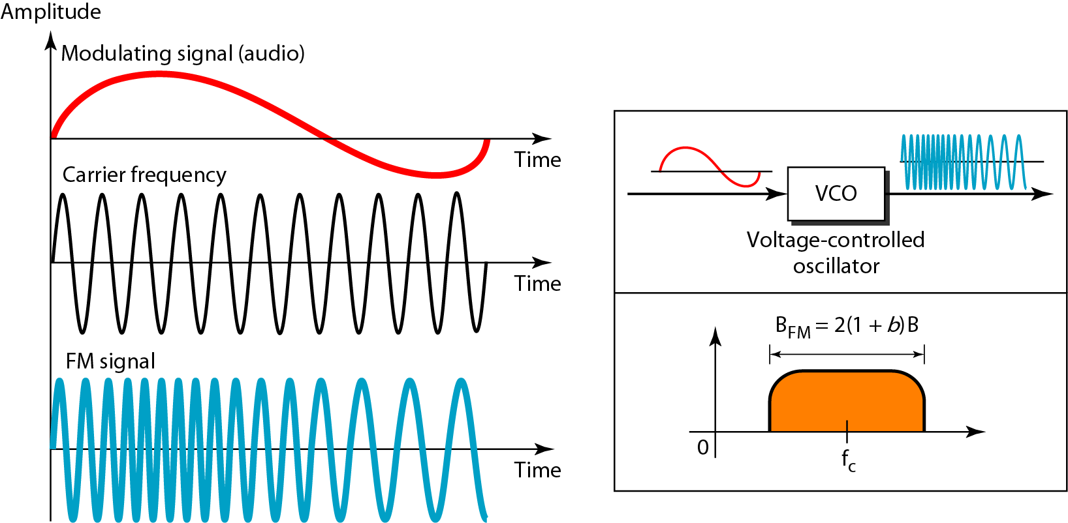
Figure 5.18 Frequency modulation

Slide 95
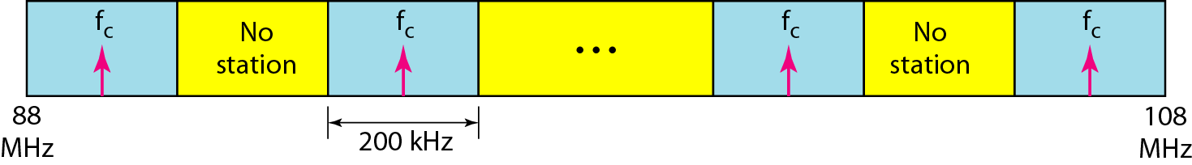
Figure 5.19 FM band allocation

Slide 96
Phase Modulation (PM)
The modulating signal only changes the phase of the carrier signal.
The phase change manifests itself as a frequency change but the instantaneous frequency change is proportional to the derivative of the amplitude.
The bandwidth is higher than for AM.

Slide 97
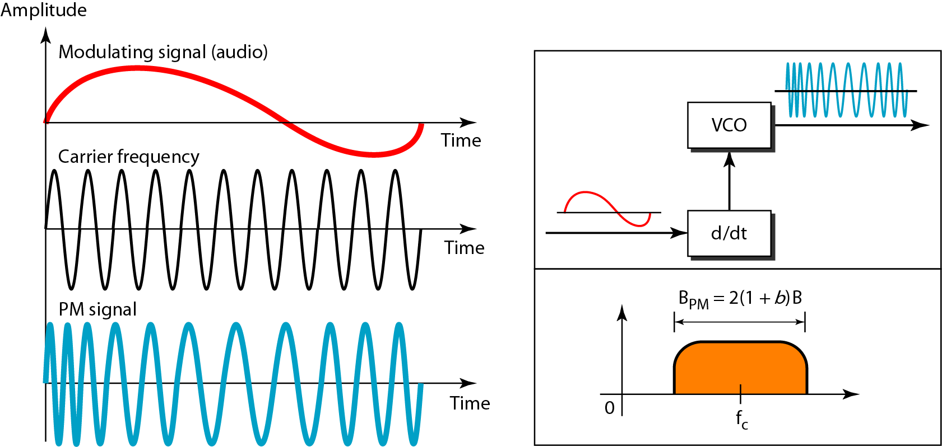
Figure 5.20 Phase modulation

